Slide 1
Natjecateljsko programiranje
Zoltan Palinkaš

Slide 2
CSES - Introductory Problems
Weird Algorithm - https://cses.fi/problemset/task/1068
Missing Number - https://cses.fi/problemset/task/1083
Repetitions - https://cses.fi/problemset/task/1069/
Increasing Array - https://cses.fi/problemset/task/1094

Slide 3
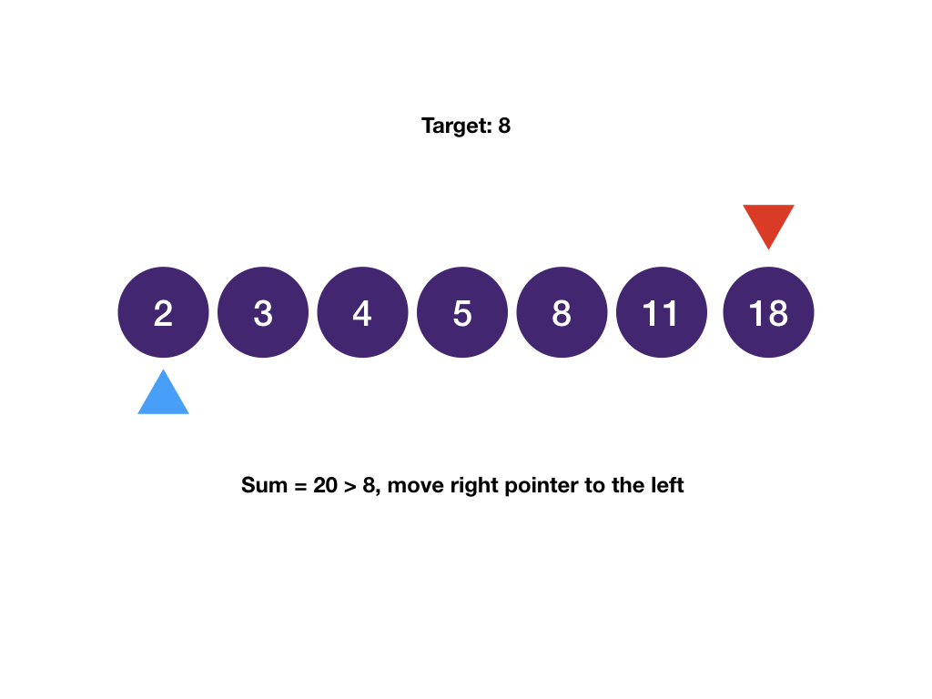
Two pointers
First method:

Slide 4
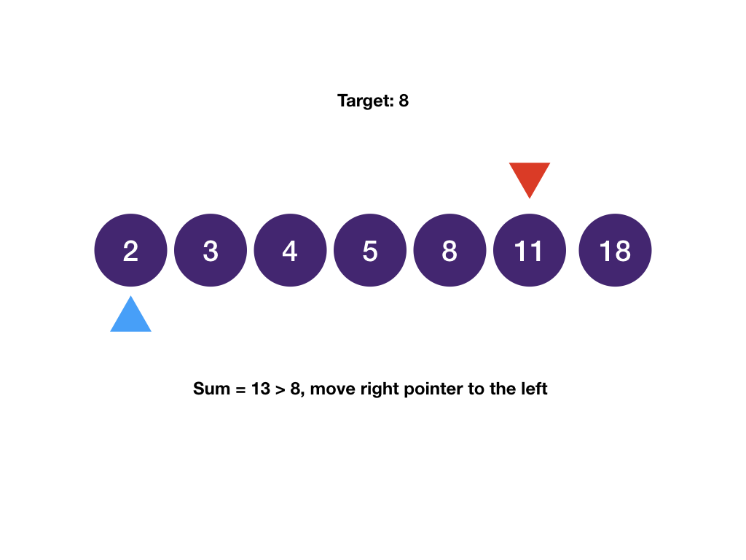
Two pointers
First method:

Slide 5
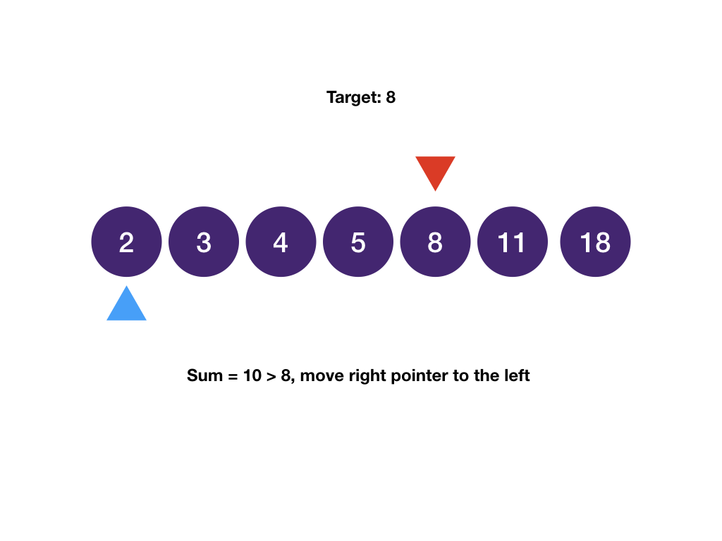
Two pointers
First method:

Slide 6
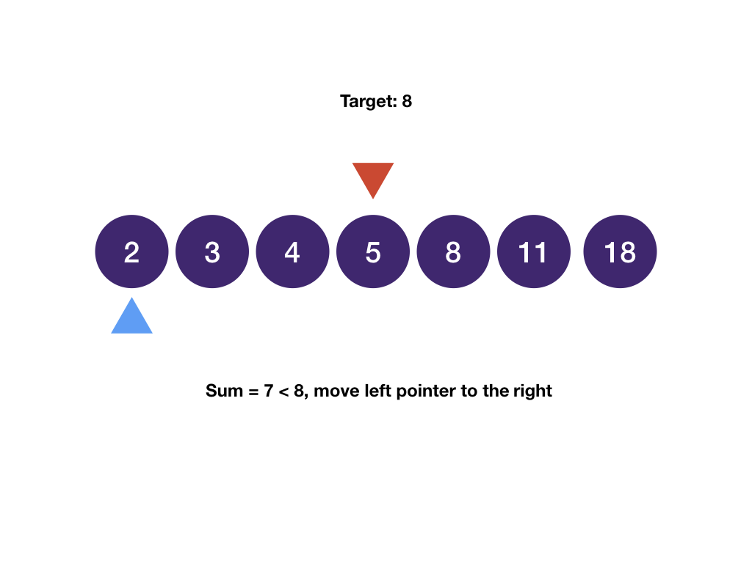
Two pointers
First method:

Slide 7
Two pointers
First method:

Slide 8
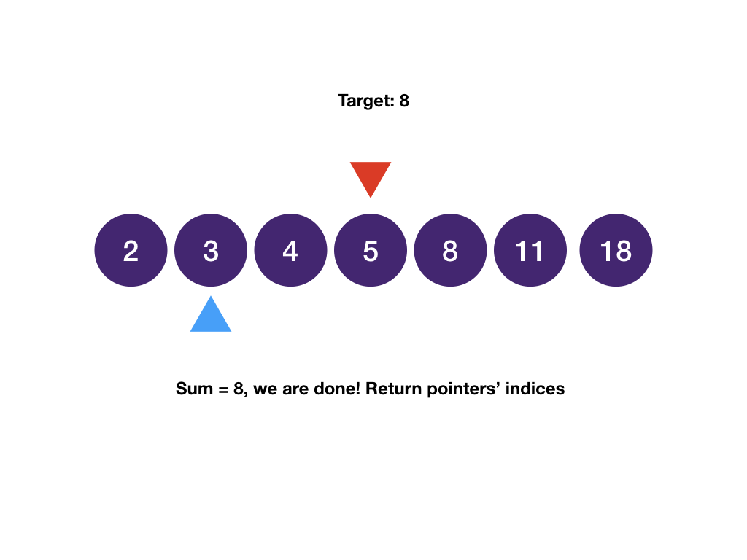
Two pointers
First method:
Sum of Two Values - https://cses.fi/problemset/task/1640

Slide 9
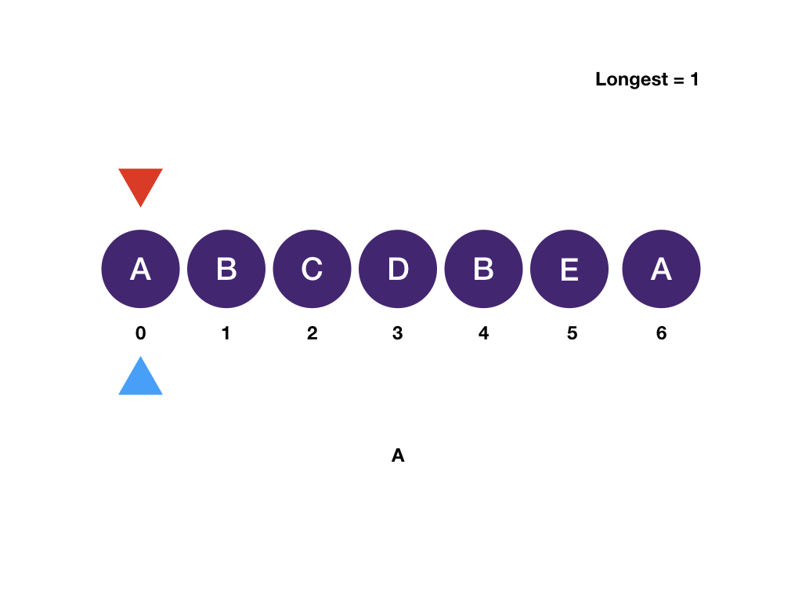
Two pointers
Second method:

Slide 10
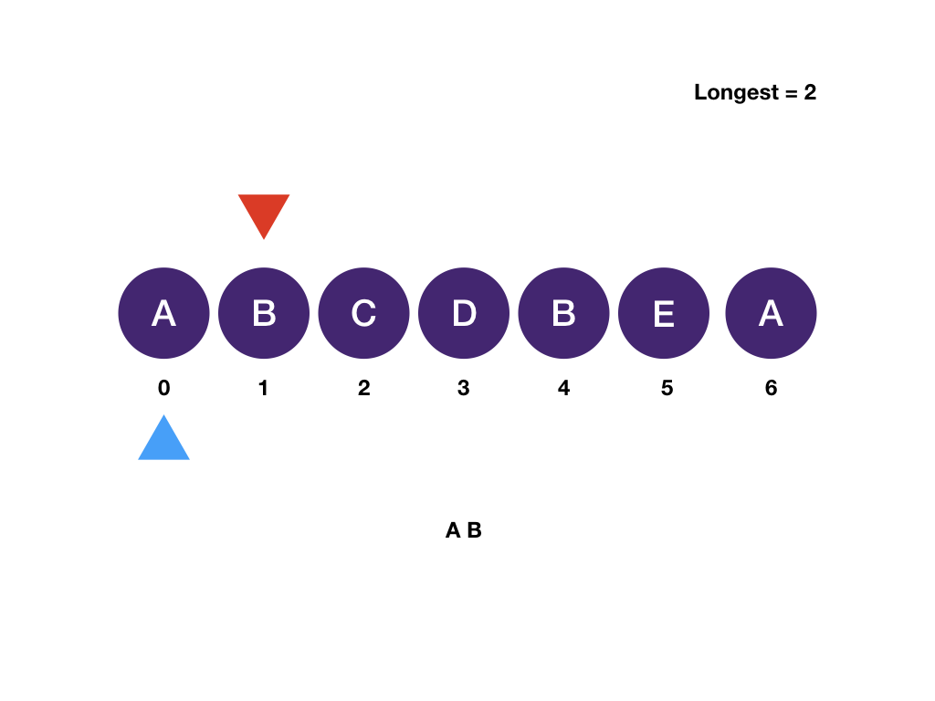
Two pointers
Second method:

Slide 11
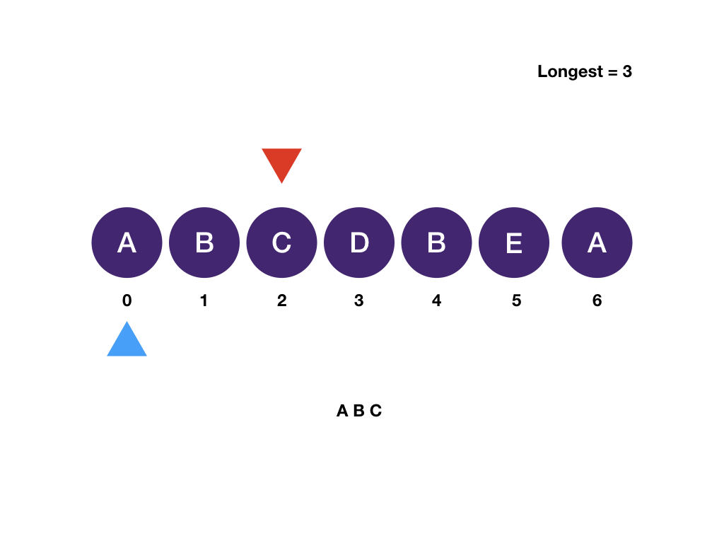
Two pointers
Second method:

Slide 12
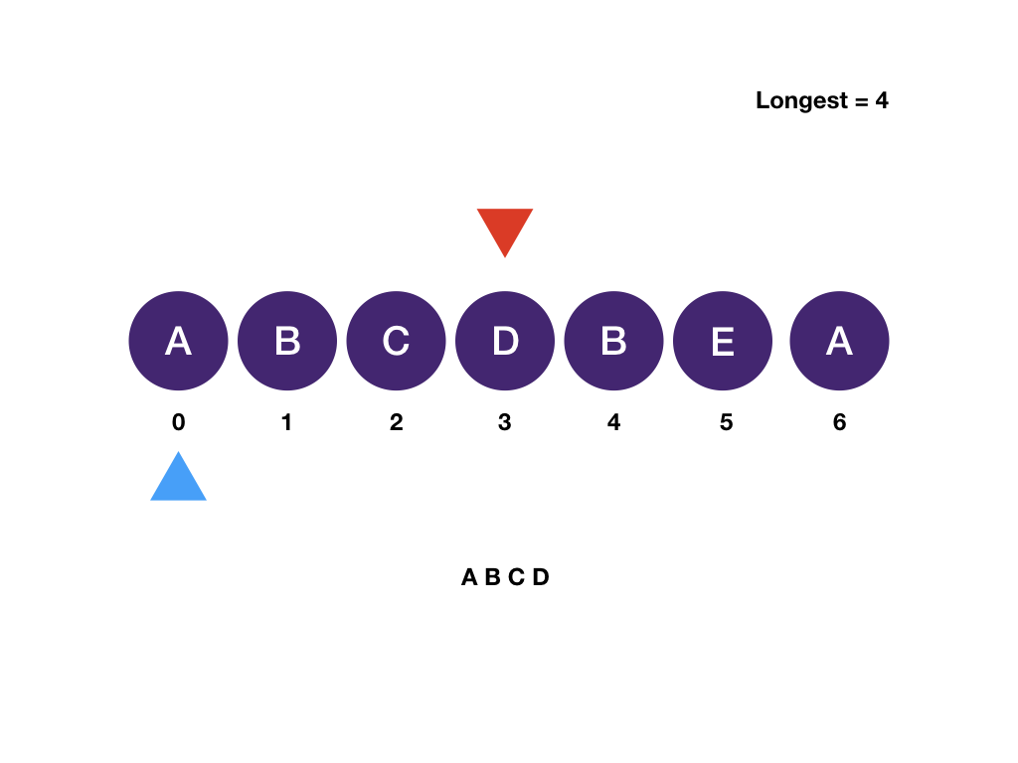
Two pointers
Second method:

Slide 13
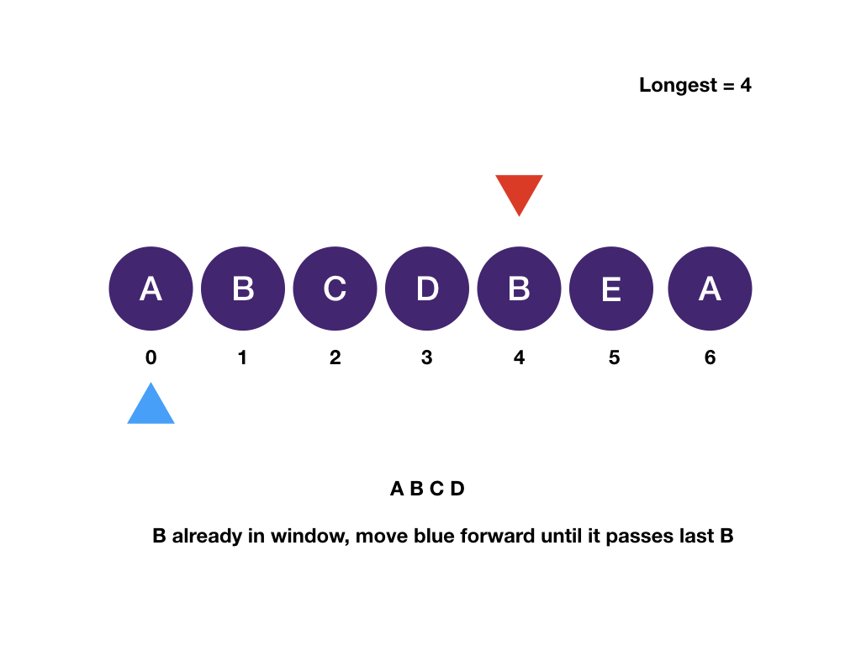
Two pointers
Second method:

Slide 14
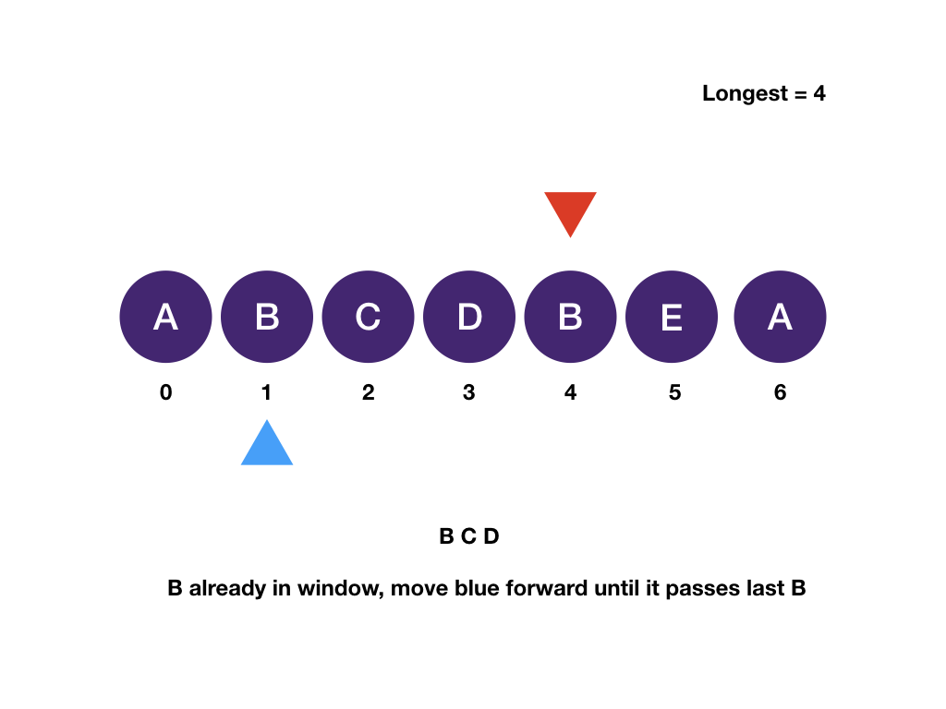
Two pointers
Second method:

Slide 15
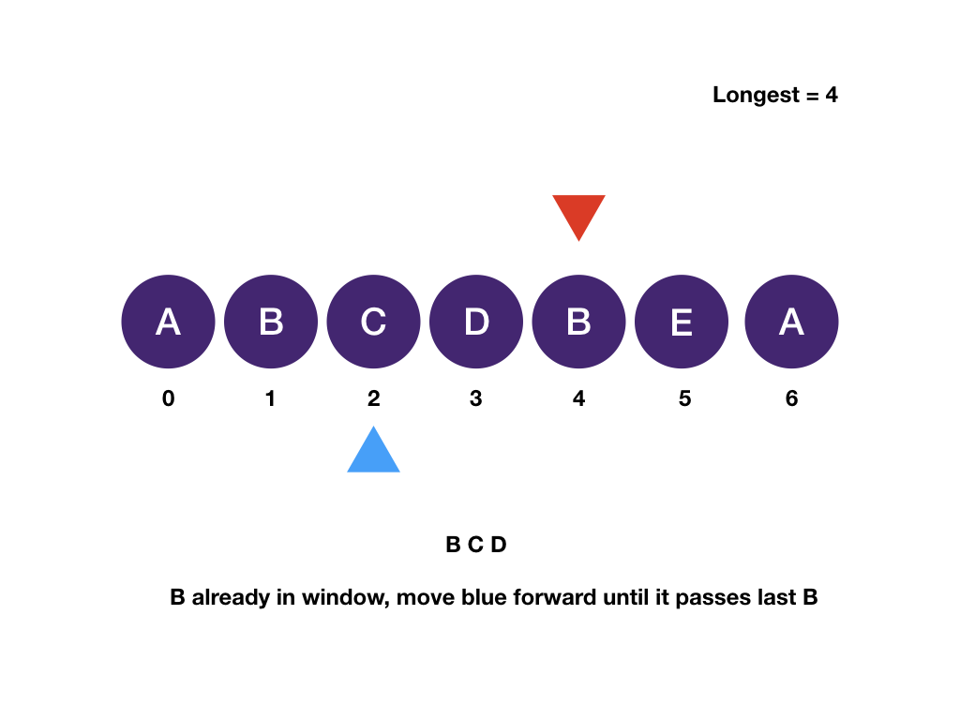
Two pointers
Second method:

Slide 16
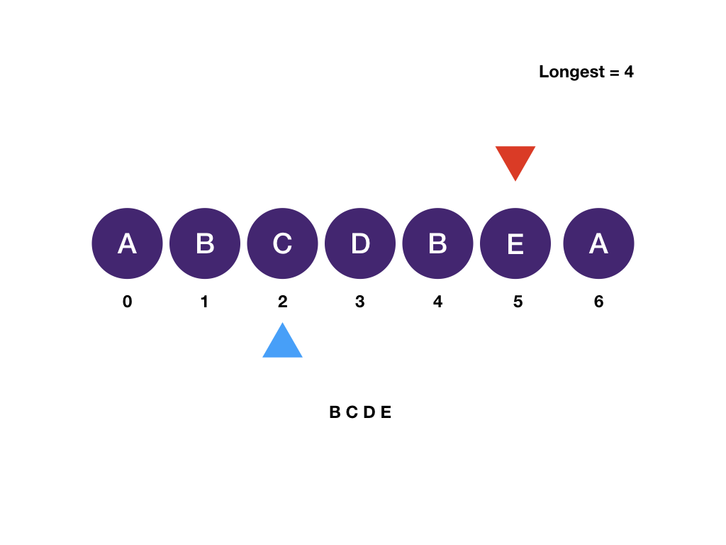
Two pointers
Second method:

Slide 17
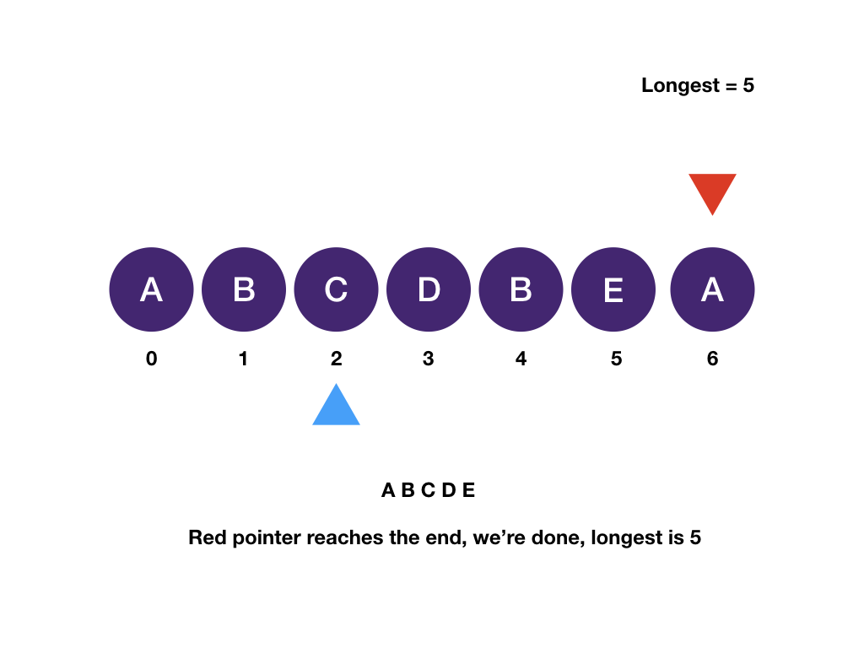
Two pointers
Second method:
Subarray Sums I - https://cses.fi/problemset/task/1660

Slide 18
CSES – Sorting and Searching
Distinct Numbers - https://cses.fi/problemset/task/1621
Apartments - https://cses.fi/problemset/task/1084
Restaurant Customers - https://cses.fi/problemset/task/1619
Movie Festival - https://cses.fi/problemset/task/1629

Slide 19
HVALA NA POZORNOSTI!
https://github.com/z0lt4np4l1nk4s/zimska_skola23

